Slide 1
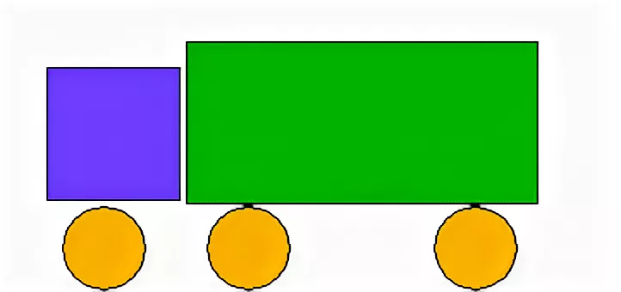

Slide 2
https://youtu.be/SAWr-KZhD0E

Slide 3
60-(43-20)=37
(28+40)-20=48
8-2+7=13
23
68
6

